Slide 1
AGXPE
Good Manufacturing Practices
Good Laboratory Practices
Good Clinical Practices
Good Engineering Practices
Good Safety Practices
Good Marketing Practices
Good Documentation Practices
Association for GXP Excellence
“Where Compliance meets Excellence ”
16-NOV-2018
http://agxpe.wildapricot.org

Slide 2
Mission
Our Mission: Develop and share quality and compliance resources to advance quality and compliance training, best practices with practical technical training information, and current compliance trends for all life science regulated companies through the expertise of our membership.

Slide 3
BOD
John Lewis – Merck (CEO)
Ken Petelinkar – BMS (CFO)
Terry McGinn – Consultant (COO)
Vince Ranieri – J&J (CAO)
Tammy Cullen – Eli Lilly
Chrissy Frey - Novartis
Maryann Fox – Adaptimmune - Member-at-Large
Bill Beyer – Life Science Training Institute - Member-at-Large
John Clifton – Industry Standard Research - Member-at-Large

Slide 4
AGXPE Platform
The AGXPE offers a platform for private and public industry leaders to:
Share best practices, and
Communicate upcoming changes in regulations, practices or libraries:
i.e. GInAS version update

Slide 5
Membership Numbers
AGXPE Membership:536
Represents ~20% increase since April 2018
Web & Social Media presence
Twitter
LinkedIn – 1425 members
Represents 50% increase since April 2018
Facebook

Slide 6
Membership - Demographics
Compliance Trainers from all organizations
Quality Assurance/ Quality Operations
Quality, Manufacturing & Packaging Leadership including:
Directors - Managers – Supervisors – Trainers - SMEs
Manufacturing API, Specialty Chem., Excipients, Biologics, Vaccines, Food, Medical Device, Laboratory, Blood Systems, Dietary Supplements, etc.
Academia
Professors - Students
Vendors/Consultants
FDA/DEA/DOH/EMA
Reciprocal agreements with similar associations
HR & Recruiters

Slide 7
2018 Conference
Le Meridien, Cambridge, MA
October 28-31, 2018
95 attendees
Segment make-up: Pharma, Medical Device, BioPharm
Vendors – 10

Slide 8
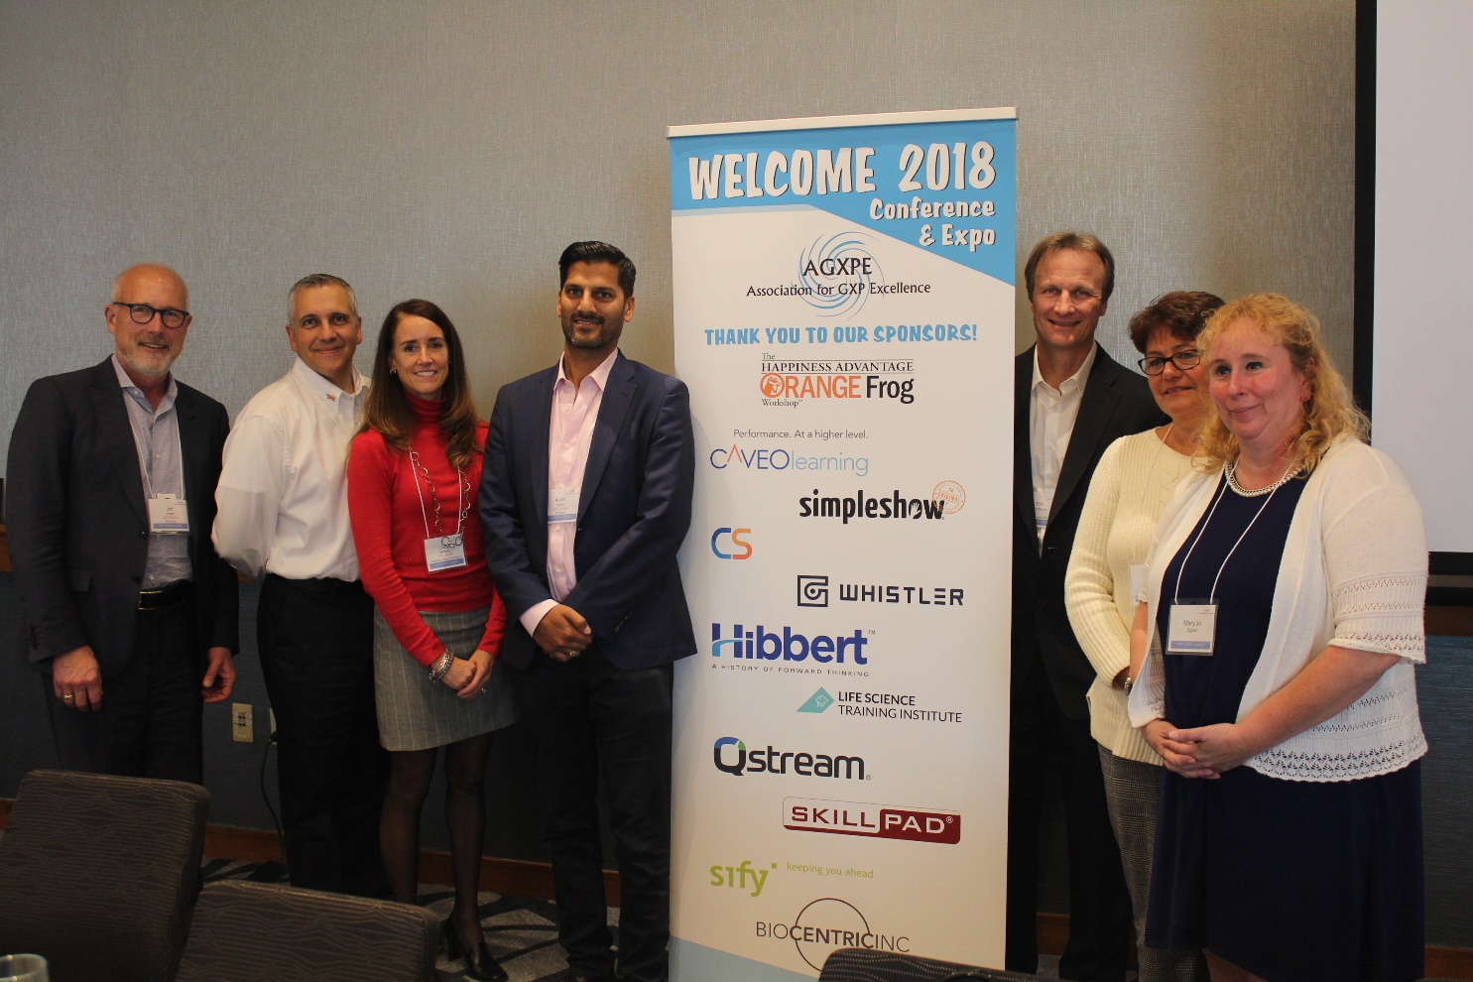
Data Integrity
Data integrity has been a big focus for the AGXPE. The conference DI Panel was a huge plus with great info shared by our SMEs.

Slide 9
Data Integrity Takeaways
Panel – recommendations
SOPs drive visibility
Global Health Authority focus
It’s not new!
Applies to all GXP areas

Slide 10
Collaboration Opportunities
AGXPE broad BOD and membership offer opportunity to bridge gaps between the agency & industry.
Welcome chance to lead collaboration for improvement of data transmission/ submissions
Recommend finding industry and agency leaders, forming an advisory panel and creating a potential project team to explore options for improvement

Slide 11
Joint Ventures
ASQ
ATD
Vendor Partnerships
ISPE
RAPS

Slide 12
Questions

